Slide 1
Salesforce — Phase 2: Step-by-Step Guide

Slide 2
Login to Salesforce
Step 1: Open Salesforce login page.
Step 2: Enter Username and Password.
Step 3: Click Login.

Slide 3
Navigate to Setup
Step 1: Click on the gear icon (⚙).
Step 2: Select 'Setup'.

Slide 4
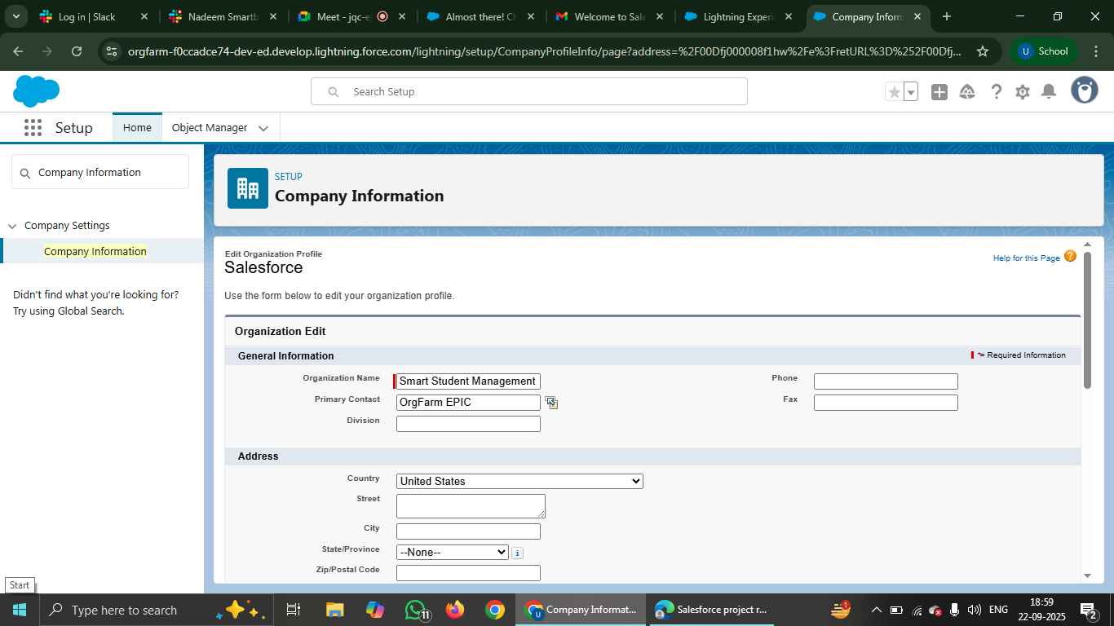
Company Information
Step 1: In Quick Find, type 'Company Information'.
Step 2: Open Company Information settings.
Step 3: Review and edit Organization details.

Slide 5
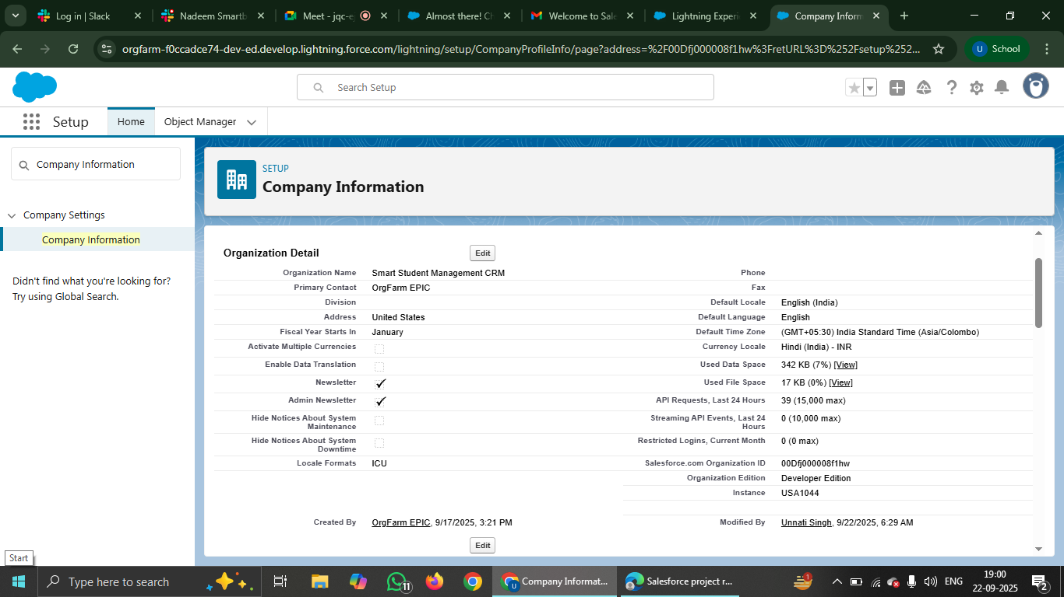
Edit Company Information
Step 1: Click 'Edit' button.
Step 2: Update Name, Address, Locale.
Step 3: Save changes.

Slide 6
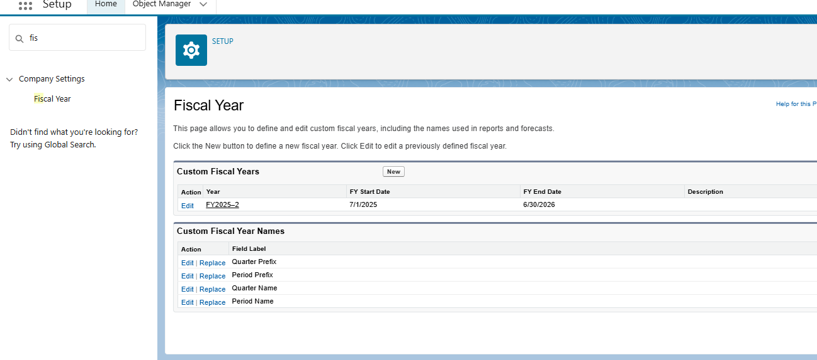
Fiscal Year Settings
Step 1: In Setup, search 'Fiscal Year'.
Step 2: Choose Standard or Custom fiscal year.
Step 3: Configure year start and end dates.

Slide 7
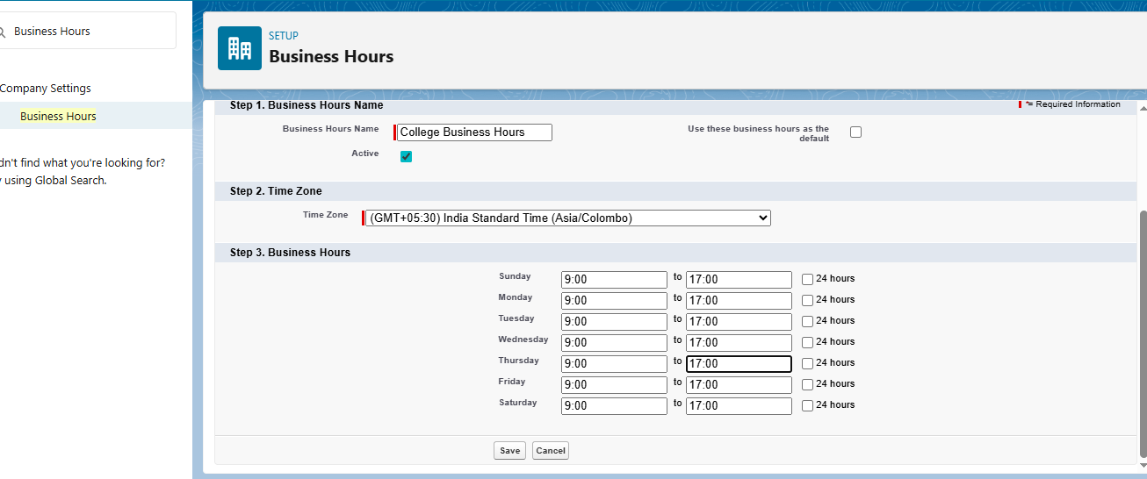
Business Hours
Step 1: In Setup, search 'Business Hours'.
Step 2: Create or edit business hours.
Step 3: Define working days and times.

Slide 8
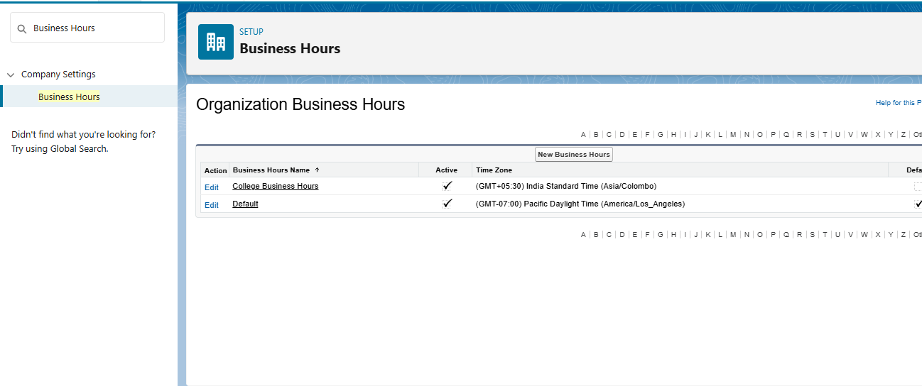
Add Business Hours
Step 1: Click 'New Business Hours'.
Step 2: Enter Name, Timezone.
Step 3: Set open and close hours.
Step 4: Save.

Slide 9
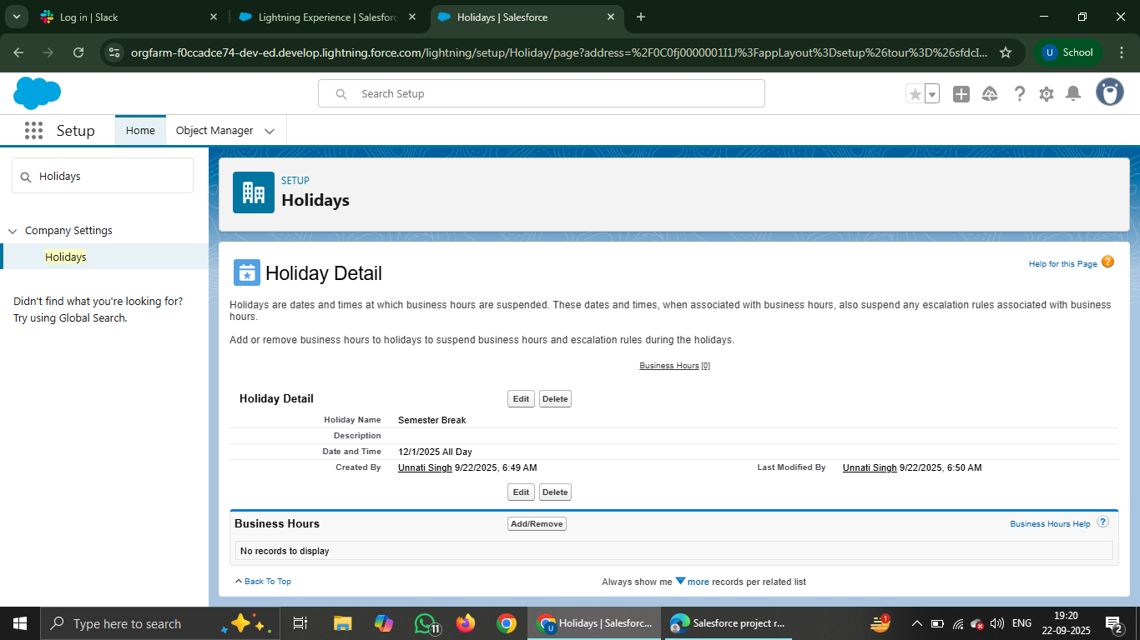
Holidays
Step 1: In Setup, search 'Holidays'.
Step 2: Click 'New'.
Step 3: Add holiday name, date range.
Step 4: Save.

Slide 10
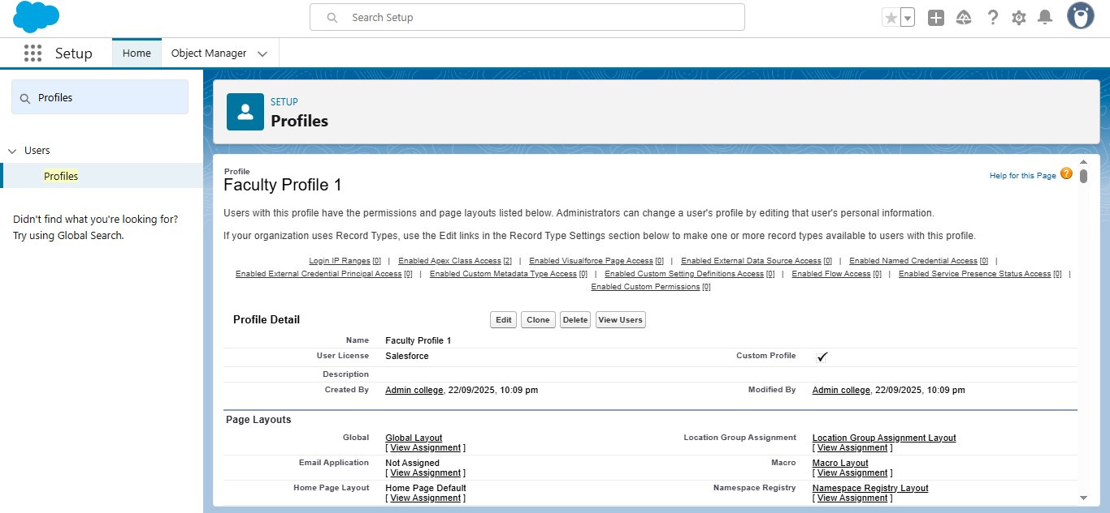
PROFILES
Step 1: In Setup, search 'Profiles'.
Step 2: Open an existing profile.
Step 3: Edit permissions and settings.

Slide 11
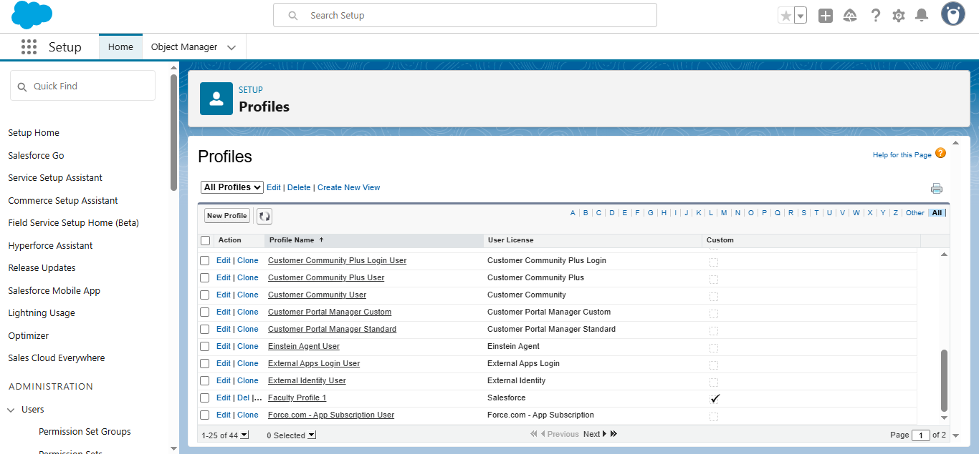
Clone Profile
Step 1: Select a profile to clone.
Step 2: Click 'Clone'.
Step 3: Enter new profile name.
Step 4: Save.

Slide 12
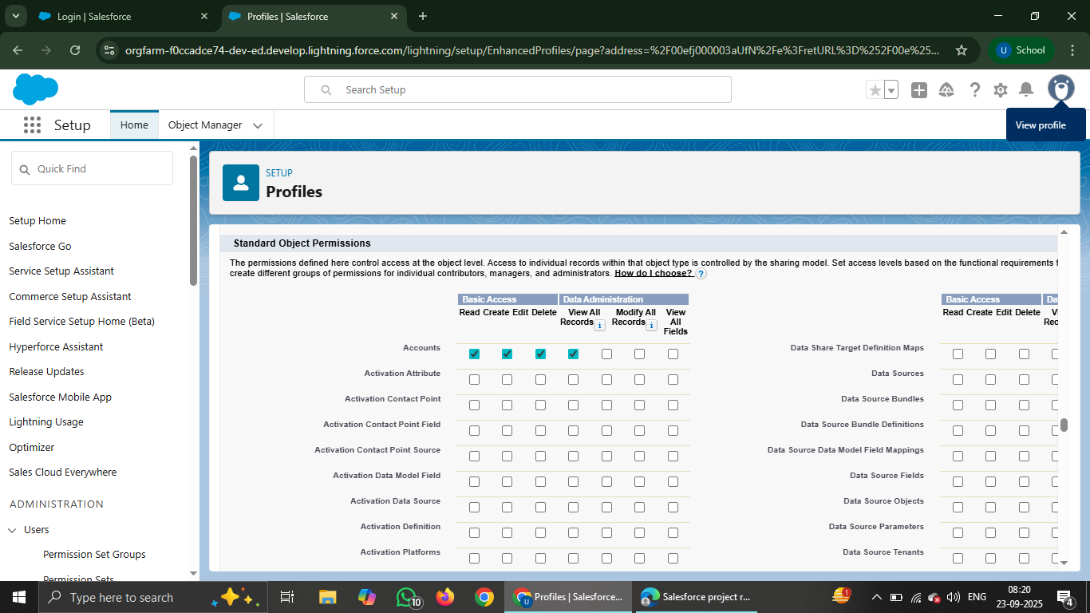

Slide 13
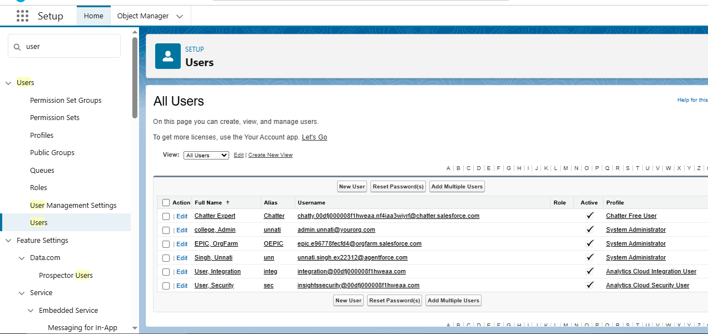
User Management
Step 1: In Setup, search 'Users'.
Step 2: Click 'New User'.
Step 3: Enter user details.

Slide 14
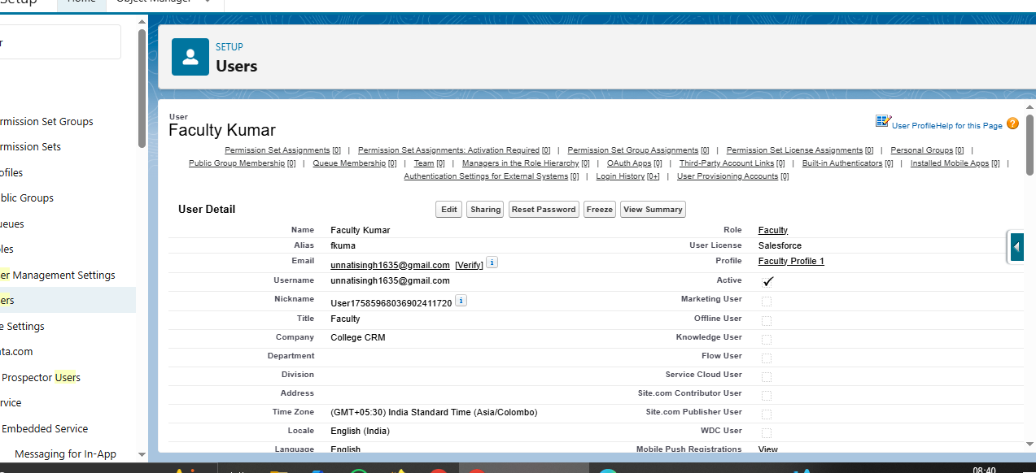
Create New User
Step 1: Fill First Name, Last Name, Email.
Step 2: Assign Username, Profile, Role.
Step 3: Select License.
Step 4: Save and send activation email.

Slide 15
Deactivate User
Step 1: Go to Users list.
Step 2: Select the user.
Step 3: Uncheck 'Active'.
Step 4: Save.

Slide 16

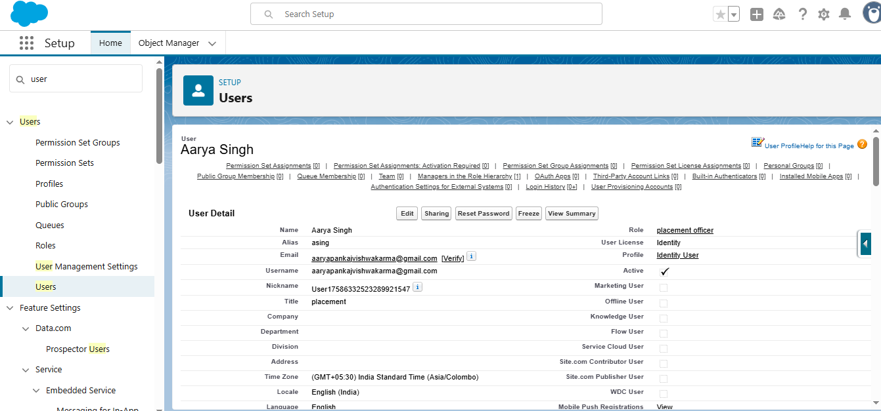

Slide 17
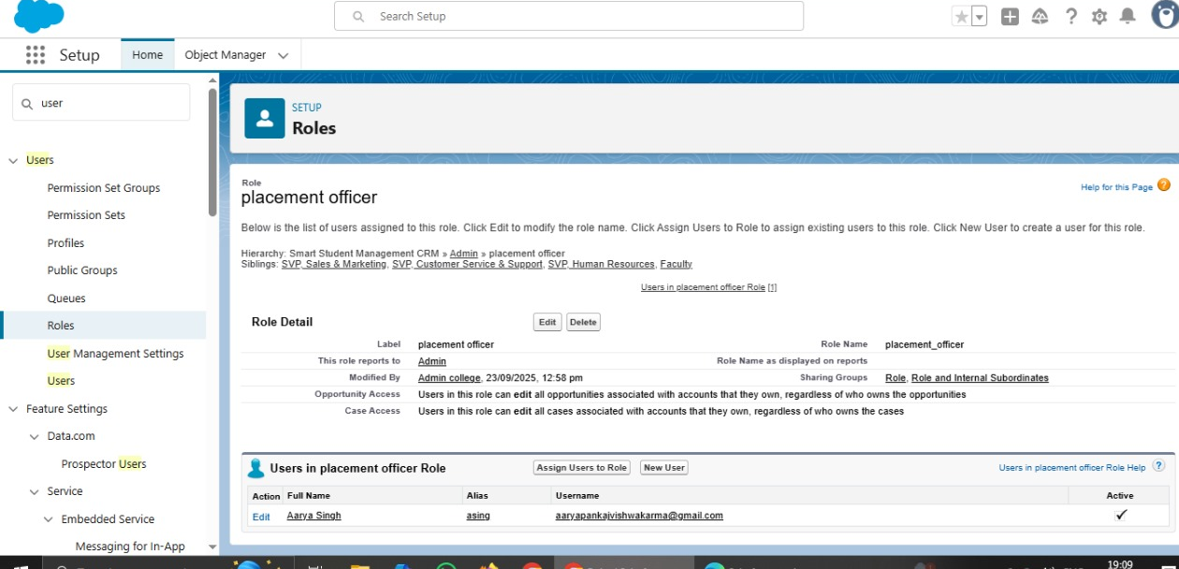
Roles
Step 1: In Setup, search 'Roles'.
Step 2: Click 'Set Up Roles'.
Step 3: View role hierarchy.

Slide 18
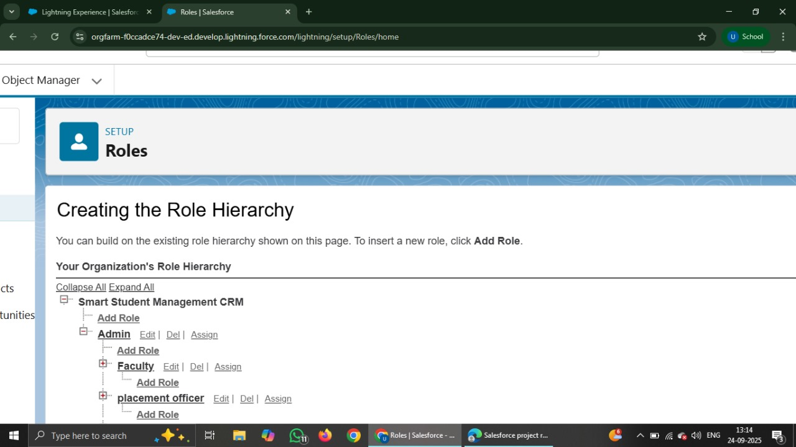
Create a Role
Step 1: Click 'Add Role'.
Step 2: Enter role name and description.
Step 3: Assign parent role if required.
Step 4: Save.

Slide 19
Assign Users to Role
Step 1: Open Role details page.
Step 2: Click 'Assign Users to Role'.
Step 3: Select and assign users.

Slide 20
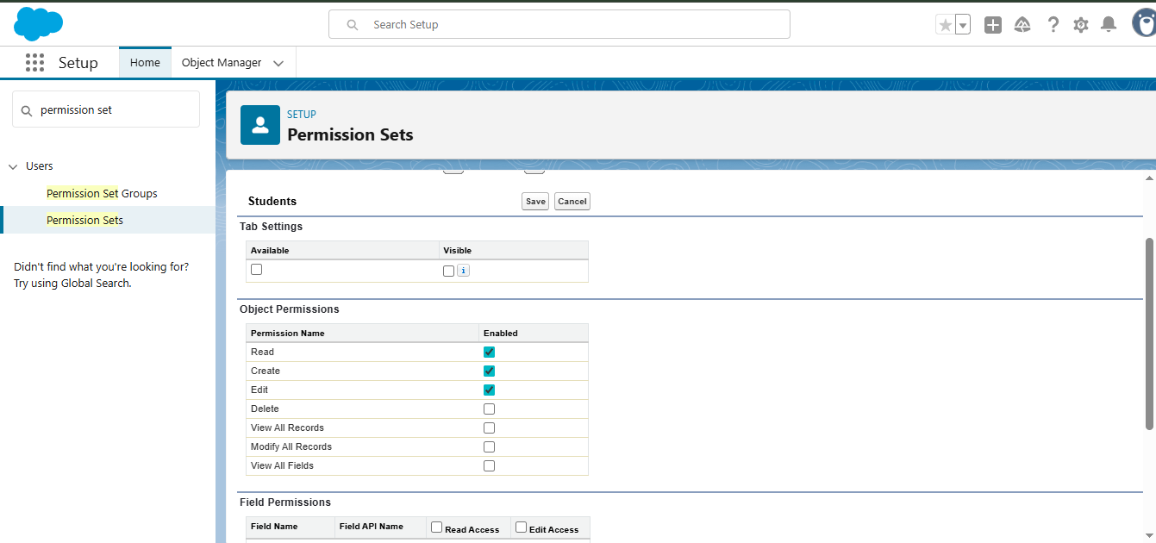
Permission Sets
Step 1: In Setup, search 'Permission Sets'.
Step 2: Create a new permission set.
Step 3: Add specific permissions.

Slide 21
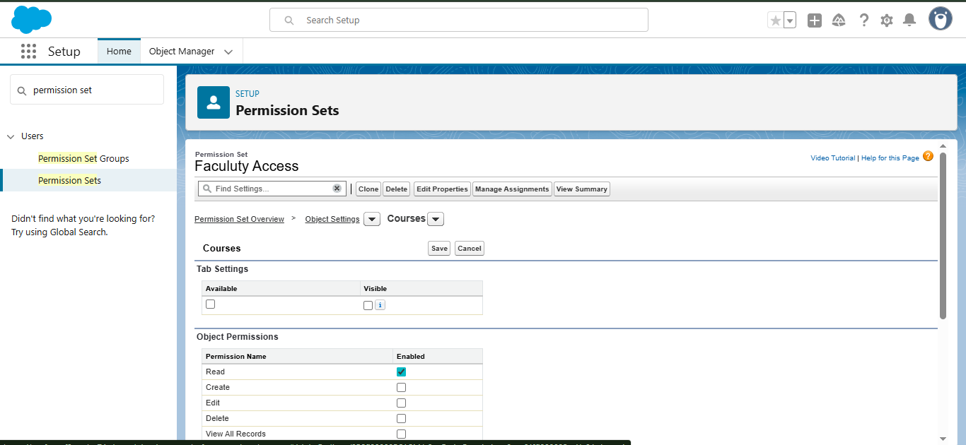
Assign Permission Set
Step 1: Open the Permission Set.
Step 2: Click 'Manage Assignments'.
Step 3: Assign to users.

Slide 22
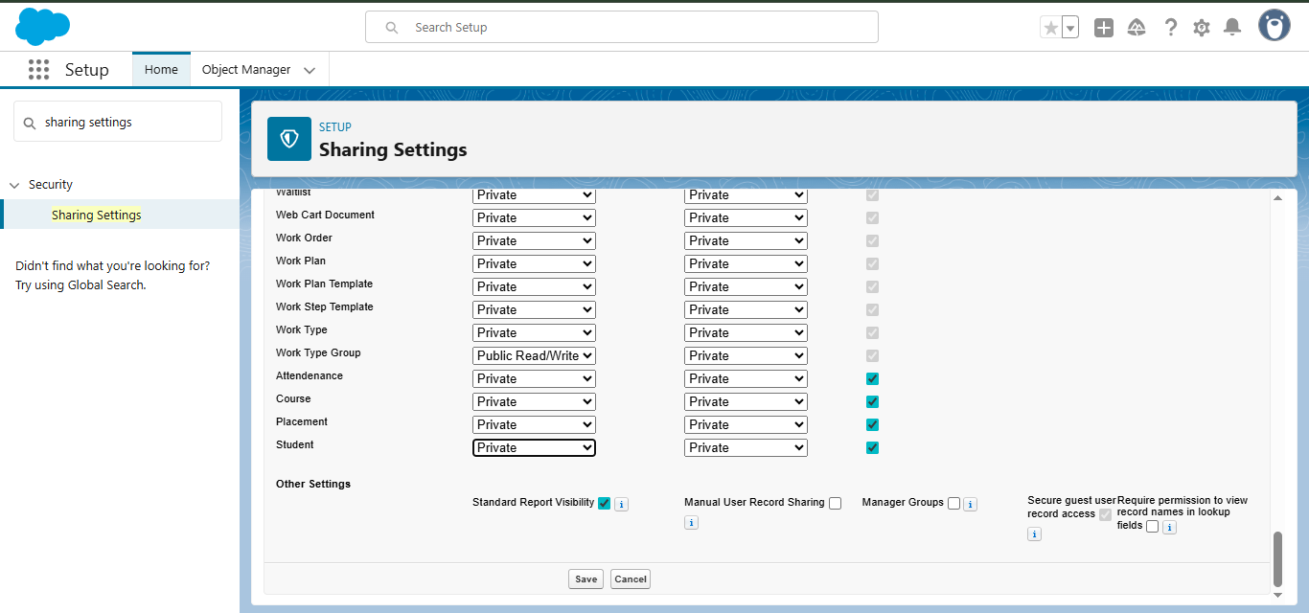
Organization-Wide Defaults
Step 1: In Setup, search 'Sharing Settings'.
Step 2: Edit OWD for each object.
Step 3: Save changes.

Slide 23
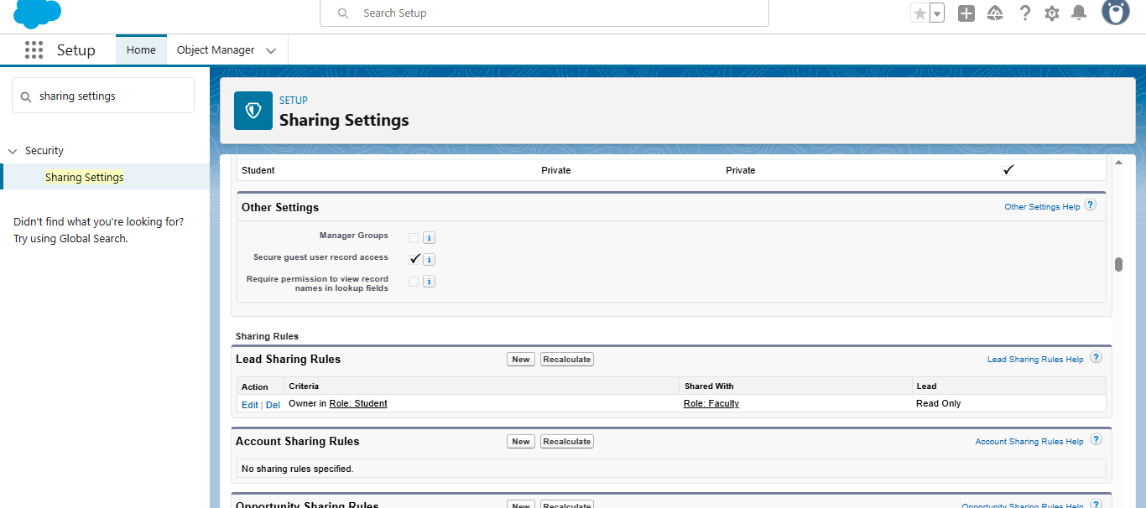
Sharing Rules
Step 1: In Setup, search 'Sharing Rules'.
Step 2: Create new sharing rule.
Step 3: Define criteria and target roles/users.

Slide 24
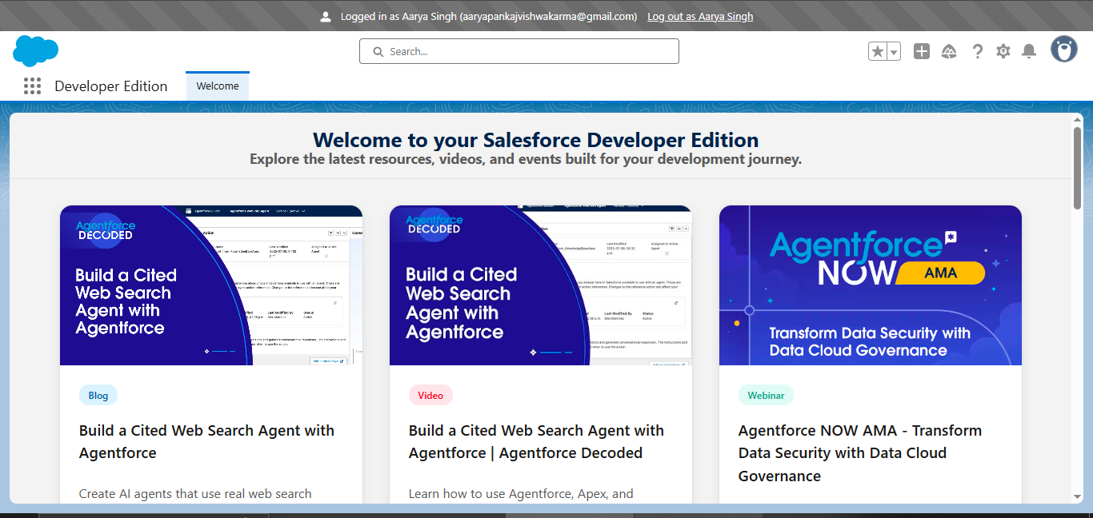
Testing User Access
Step 1: Login as a test user.
Step 2: Verify permissions (create, edit, delete).
Step 3: Adjust if issues occur.

